Slide 1

MASCDetector
One Step Towards Tech ...

Slide 2
GROUP MEMBERS
INSTRUCTOR AND GUIDE
Dr. Kannan Shanmugam
Amaan Ali Khan
Team Leader and ML Developer
19BCE10201
Akshay Kokadwar
Android Leader
19BCE10251
Ashwini Darade
Content Writer
19BCE10311
Ashi Sachan
Graphic Designer
19BCE10108

Slide 3
CONTENTS
INTRODUCTION
PROBLEM STATEMENT
OVERALL SYSTEM ARCHITECTURE DIAGRAM
FLOW DIAGRAM
COMPLETE MODULE SPLIT UP & EXPLANATION
50% MODULE IMPLEMENTATION & DEMO
REFERENCES

Slide 4
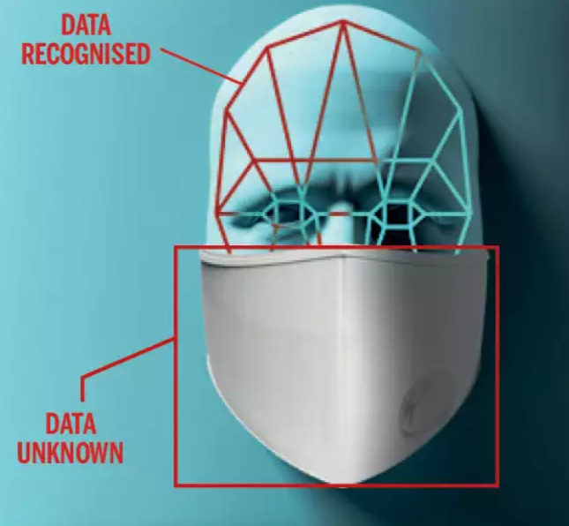
INTRODUCTION
People around the world have been pushed to
new challenges by the coronavirus pandemic.
In today's world, masks have become a necessity.
Masks have become a major prerequisite before stepping out as a result of Covid-19.
It grew into a modern standard.
This is also something that will be expected in the future.

Slide 5
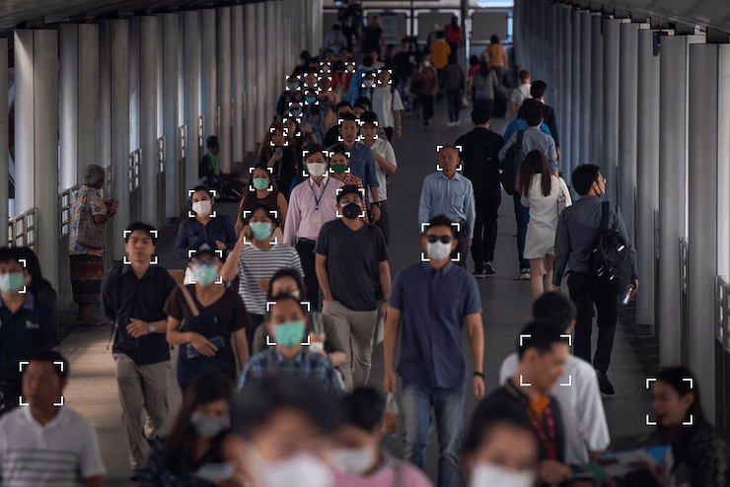
PROBLEM STATEMENT
People wear masks in many places
For instance in official and public places it is difficult to catch people who don’t wear mask, particularly in areas of government premises.
So we come with the solution of detecting who is wearing a mask or not

Slide 6
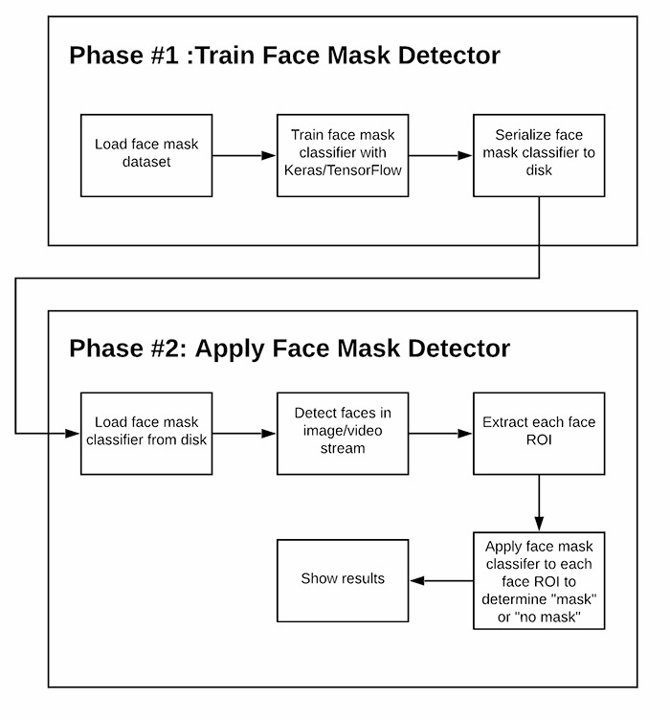
FLOW DIAGRAM

Slide 7
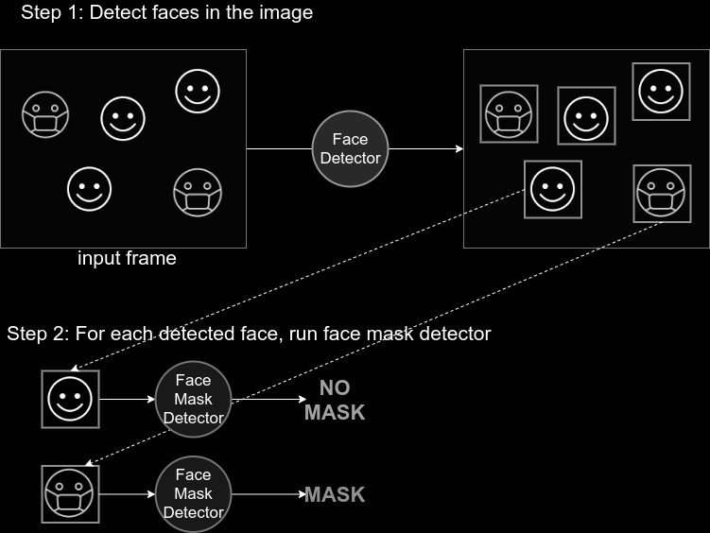
OVERALL ARCHITECTURE DIAGRAM

Slide 8
COMPLETE MODULE SPLIT-UP AND EXPLANATION
In order to train a custom face mask detector, we need to break our project into two distinct phases, each with its own respective sub-steps
Training: Here we’ll focus on loading our face mask detection dataset from disk, training a model (using Keras/TensorFlow) on this dataset, and then serializing the face mask detector to disk
Deployment: Once the face mask detector is trained, we can then move on to loading the mask detector, performing face detection, and then classifying each face as with_mask or without_mask

Slide 9
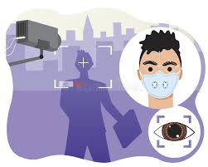
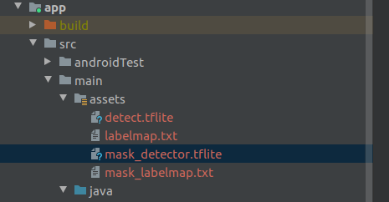
COMPLETE MODULE SPLIT-UP AND EXPLANATION
Converting model from Keras to TensorFlow Lite
In this case we are going to use the TocoConverter python class to migrate from the Keras ‘.h5’ format to the TensorFlow Lite ‘.tflite’ format.
then the TensorFlow Lite model file was added to the assets folder of the project

Slide 10
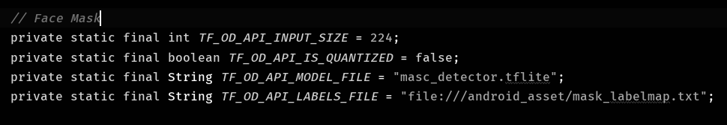
And then the required parameters to fit our model requirements in the DetectorActivity configuration section were adjusted. We set the input size of the model to TF_OD_API_INPUT_SIZE = 224, and TF_OD_IS_QUANTIZED = false. We need to point to the mask detector file. Also we can create a label map text file with the classes names "mask" and "no-mask". Also we define a larger preview size to (800x600) px. to have better resolution for our detector.

Slide 11
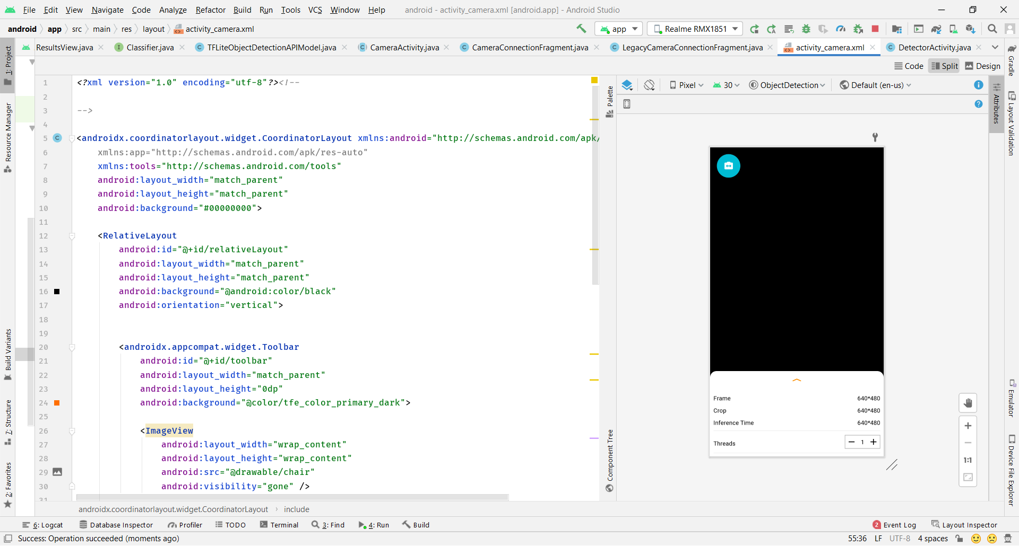
Module Implementation & Demo

Slide 12
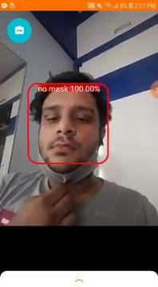
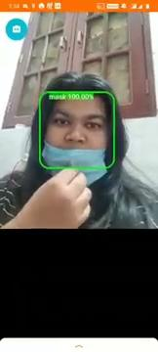
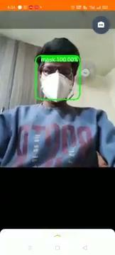

Slide 13
REFERENCES
Face Detection
Python 3.9.2 Documentation
Documentation for Android app developers
Transfer Learning
Transfer learning (2)
google ml kit
reference
COCO dataset
MobileNetV2
Object detection

Slide 14

Team MASCDetector
THANK YOU!!

